Slide 1

Testing
Unit Tests, Mocking, Integration Tests, Selenium
SoftUni Team
Technical Trainers
Software University
https://softuni.bg

Slide 2
Table of Contents
Testing
Unit Testing
Mocking
In-memory Database
Integration Testing
Selenium
Selenium Integration
MyTested.AspNetCore.Mvc

Slide 3
Have a Question?
sli.do #csharp-web

Slide 4

Testing

Slide 5

Testing
Testing is an important part of the application lifecycle
New features need to be verified, before delivered to the clients
Testing checks whether software conforms to the requirements, aims to find defects
Testing is a wide area of application development
There are several levels of testing, many concepts of development and different types of testing
Web applications also need testing for "unintentional features"
Controllers, Services, Custom Components, etc.
Every component of the application must be tested

Slide 6
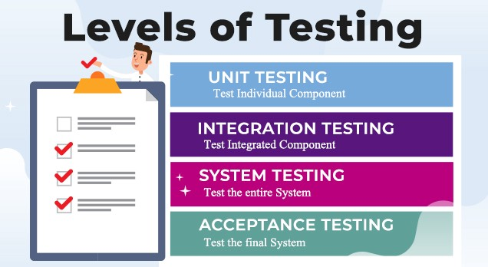
Main Test Levels
Different components of the application are tested on different levels:
Unit tests
Test single component
Created by developers
Integration tests
Test interaction between components (e. g. APIs)
Created by developers / QA automation engineers
System tests / end-to-end tests
Test the entire system (created by QA automation engineers)
Notes:
Software testing is done at several levels:
unit testing, integration testing and system testing.
Unit tests test a single component (called "unit").
This can be a function or method in the code, a class or other code component.
For example, a set of unit tests can demonstrate that
the service for registering a new user checks for duplicated username and invalid password
and when the input data is correct, it stores the new user in the user repository.
In this case, the unit test will not use a real database (which is an external component).
Instead it will use a fake implementation (mock) of the functions
for accessing the user repository (the database table holding the users).
This way the unit tests check only certain component,
isolated from the other components, which may not exist at this time.
Unit testing aims to verify each component of the software
by isolating it from the other components
and then perform tests to demonstrate that it works correctly.
When a component is dependent on other components,
the external dependencies are replaced during the testing
by mock objects, stubs or using other techniques.
Unit tests are automated tests, written by developers,
that examine the functionality of single component (or unit).
They are small pieces of code (functions or methods),
which automate the testing of certain unit.
Unit testing is performed at the earliest stages of the development process,
long before the software is developed and ready for testing by QA engineers.
When unit testing is implemented,
for each unit, developers write multiple unit tests,
to cover fully its functionality.
Unit tests are examples of automated, functional, white-box tests,
based on a unit testing framework,
such as JUnit, NUnit or Mocha.
We shall learn how to write simple unit tests with live code examples later.
Integration tests check the interaction between several components.
For example, if we test whether the user registration service in the back-end
correctly stores the new user to the database, this is an integration test.
This integration test checks several components together:
the user registration function in the back-end API,
the data access logic,
and the database.
This integration test does not test the entire system.
It does not care about the front-end and the user interface.
Integration tests are examples of automated, white-box, functional tests,
and are usually based on some unit testing framework.
The difference between unit testing and integration testing is that
unit tests examine the functionality of a single unit and they mock the external dependencies,
while integration tests examine the functionality on several units together
and test the integration between the dependent units.
Unit tests are more-simple than the integration tests
and have smaller scope, usually a single public method (or function).
Integration tests implement more complex scenarios.
They test together multiple interconnected components and subsystems.
Integration testing is performed early in the development process,
after some of the components are written and unit tested,
and they need to be integrated together into modules with more complex functionality.
Integration tests are usually written by developers, not by QAs.
We shall learn how to write simple integration tests with live code examples later.
System tests and acceptance tests test the entire system: all its components together.
System tests are manual or automated tests, which cover end-to-end scenarios:
from the front-end, to the back-end, the database and all other system components.
For example, if we test whether after user registration in the mobile app of complex software system,
the new user is correctly stored in the database at the server side, this is a system test.
This system test checks all system components together:
the user interface (the front-end), which is the mobile app in our scenario,
the back-end services at the server side, which are called by the mobile app,
the data access logic, implemented in the back-end to access the database,
and the database server, which stored the app data.
To implement this system test, QA engineers
run the software in a testing environment,
create a database, holding sample testing data,
run the back-end server-side components,
run the front-end component (the mobile app in our scenario),
fill some data in the user registration form, submit the data,
and check the behavior of the mobile app.
The above steps can either be done by hand (manual system testing)
or can be automated (automated system testing).
Automated system testing can be implemented by using DevOps tools and techniques
to automatically deploy and run the required system components
and perform UI tests in the mobile app, using a mobile testing framework.
System testing is performed late in the development process,
when the entire system is ready or partially ready.
System testing is usually performed by QA engineers or test automation engineers.
Modern development processes integrate system testing in the CI/CD pipeline.
Projects with less QA resources implement automated smoke tests during the system testing phase.
The smoke tests check whether the most important functionality works in the most common scenarios.
They just check whether the system is broken or not, without verifying each of its functions.
An example of smoke test could be to check whether the home page of the system opens correctly.
Projects with more QA resources automate the testing of the entire system
with all its functionality, covering all its use cases.
This approach is heavy and time consuming and is rarely used.
Most modern projects automate the system testing for the most important scenarios,
not the entire system with all its components.
Acceptance testing is an extension to system testing, where
the QA team or the project sponsor checks how the product will perform
when it is installed on the user’s system.
Acceptance tests are usually more intensive and more comprehensive than the system tests
and should cover the entire functionality of the software.
The aim of acceptance testing is to evaluate whether the system complies with the end-user requirements
and if it is ready for deployment in the production environment.

Slide 7
More Test Levels
Test Level | Description
Unit Testing | Tests individiual parts of the code, independent from the infrastructure
Component Testing | Testing of multiple functionalities (a single component)
Integration Testing | Testing of all integrated modules to verify the combined functionality
System Testing | Tests the system as a whole, once all the components are integrated
Regression Testing | Ensures that a fixed bug won't happen again
Acceptance Testing | Tests if the product meets the client's requirements. Purely done by QAs
Load / Stress Testing | Test the application's limits by attempting large data processing and introducing abnormal circumstances and conditions
Security Testing | Test if the application has any security flaws and vulnerabilities
Other Types of Testing | Manual, automation, UI, performance, black box, end-to-end testing, A/B, etc

Slide 8
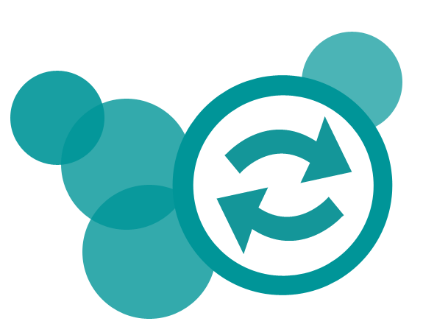
Test Concepts
There are also different concepts and practices of test development
Code-first approach (The usual Development)
Test-first approach (Test-Driven Development)
Each has its own advantages and disadvantages
The Code-first approach ensures flexibility & fast development
The Code-first approach tends to create tests based on the code
The Test-first approach ensures quality and edge case coverage
The Test-first approach is complicated and is an "initial delay"

Slide 9
The "AAA" Testing Pattern
Automated tests usually follow the "AAA" pattern
Arrange: prepare the input data and entrance conditions
Act: invoke the action for testing
Assert: check the output and exit conditions
[Test]
public void Test_SumNumbers()
{
// Arrange
var nums = new int[] {3, 5};
// Act
var sum = Sum(nums);
// Assert
Assert.AreEqual(8, sum);
}

Slide 10

Unit Testing

Slide 11
Unit Testing
Unit Testing web apps is pretty much like casual unit testing
Writing test methods to test classes and methods (functionalities)
Testing individual code components (units), not the infrastructure
You still use the same testing frameworks as in casual unit testing
void Test_SumTwoNumbers() {
var summator = new Summator();
if (summator.Sum(new int[]{1, 2}) != 3)
throw new Exception("1+2 != 3");
}
public class Summator
{
public int Sum(int[] arr)
{
int sum = arr[0];
for (int i = 1; i < arr.Length; i++)
sum += arr[i];
return sum;
}
}

Slide 12
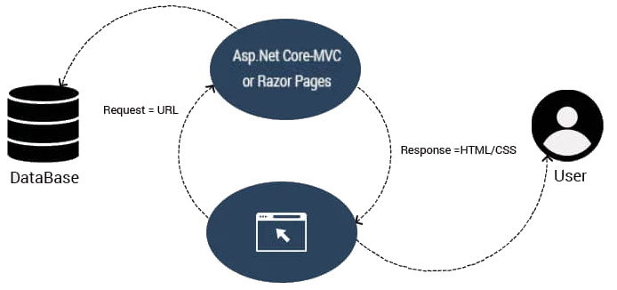
Unit Testing in ASP.NET Core
When using a web frameworks such as ASP.NET Core
Built-in logic does not need to be tested
It is already tested during the development of the framework itself
Example of MVC tests: https://github.com/dotnet/ aspnetcore/tree/main/src/Mvc/test
You still need to test your custom functionality
Don't test

Slide 13

NUnit
Unit-Testing Framework for All .NET Languages

Slide 14

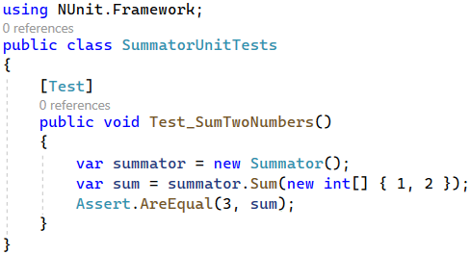
NUnit: Overview
NUnit == popular C# testing framework
Supports test suites, test cases, before & after code, startup & cleanup code, timeouts, expected errors, …
Like JUnit (for Java)
Free, open-source
Powerful and mature
Wide community
Built-in support in Visual Studio
Official site: nunit.org

Slide 15
NUnit Assertions
Assert that condition is true
Comparison (equal, greater than, less than or equal, …)
Range assertions
String assertions
And many more: https://docs.nunit.org/articles/nunit/writing-tests/assertions/assertion-models/classic.html
Assert.That(bool condition);
Assert.AreEqual(expected, actual);
Assert.That(number, Is.InRange(80, 100));
Assert.That(string actual, Does.Contain(string expected));

Slide 16
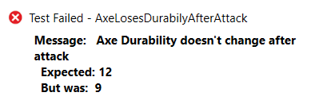
NUnit Assertion Messages
Assertions can show messages to helps with diagnostics
Assert.That(axe.DurabilityPoints, Is.EqualTo(12),
"Axe Durability doesn't change after attack");
Failure messages in the tests help finding the problem

Slide 17
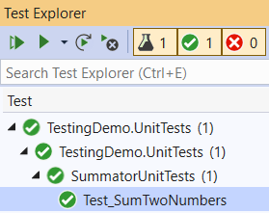
Test Classes and Test Methods
Test classes hold test methods:
Import NUnit
using NUnit.Framework;
[TestFixture]
public class SummatorTests
{
[Test]
public void Test_SumTwoNumbers() {
var summator = new Summator();
var sum = summator.Sum(new int[] { 1, 2 });
Assert.AreEqual(3, sum);
}
}
Optional notation
Test class
Test method
Assertion

Slide 18
Initialization and Cleanup Methods
private Summator summator;
[SetUp] // or [OneTimeSetUp]
public void TestInitialize()
{
this.summator = new Summator();
}
[TearDown] // or [OneTimeTearDown]
public void TestCleanup()
{
// …
}
Executes before each test
Executes after each test

Slide 19

Mocking
Simulating External Dependencies in Unit Tests

Slide 20
What is Mocking?
Mocking – something made as an imitation
Mocking is a software practice, primarily used in Unit Testing
An object under test may have dependencies on other objects
To isolate the behavior, the other objects are replaced
The replacements are mocked objects
The mocked objects simulate the behavior of the real objects
Useful if the real objects are impractical/incorporate to the unit test
Basically, Mocking is creating objects that simulate behavior
In .NET, we can use the Moq library to create mock objects

Slide 21
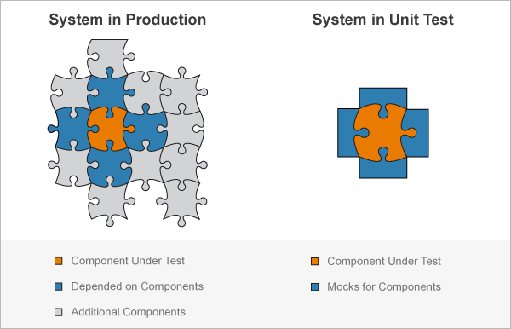
Why Mocking?
Unit testing should test a single component
Isolated from all the others
External dependencies should be mocked (faked, simulated)

Slide 22
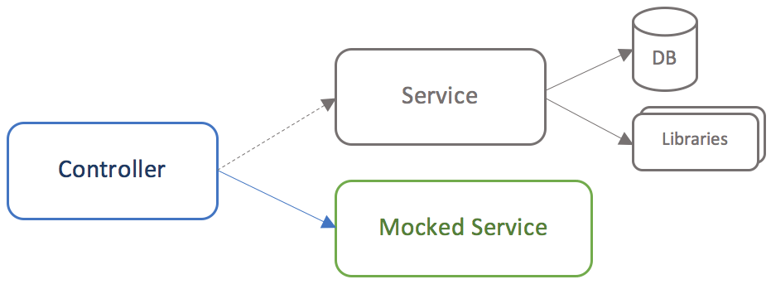
Mocking
Mocking simulates the behavior of real objects
Usually done through interfaces
Real implementation (e. g. with a database)
Fake implementation (used for the unit tests)
Used in tests
Fake (mock) implementation of the service interface

Slide 23
Testing a Service with Mocking (1)
public interface ICreditDecisionService
{
string GetDecision(int creditScore);
}
public class CreditDecisionService
: ICreditDecisionService
{
public string GetDecision
(int creditScore)
{
if (creditScore < 550)
return "Declined";
else if (creditScore < 675)
return "Maybe";
else
return "Absolutely";
}
}
public class CreditDecision
{
ICreditDecisionService service;
public CreditDecision(ICreditDecisionService service)
=> this.service = service;
public string MakeCreditDecision(int creditScore)
=> service.GetDecision(creditScore);
}

Slide 24
Testing a Service with Mocking (2)
[TestFixture]
public class CreditDecisionTests
{
[Test]
public void MakeCreditDecision_ShouldReturnCorrectResult()
{
var mockCreditDecisionService = new Mock<ICreditDecisionService>();
mockCreditDecisionService
.Setup(p => p.GetDecision(100))
.Returns("Declined");
var controller = new CreditDecision(mockCreditDecisionService.Object);
var result = controller.MakeCreditDecision(100);
Assert.That(result, Is.EqualTo("Declined"));
mockCreditDecisionService.VerifyAll();
}
}
NOTE: You will need the following NuGet package installed: Moq
Mock the service
Use the mocked service
You can look at a more complex example here

Slide 25
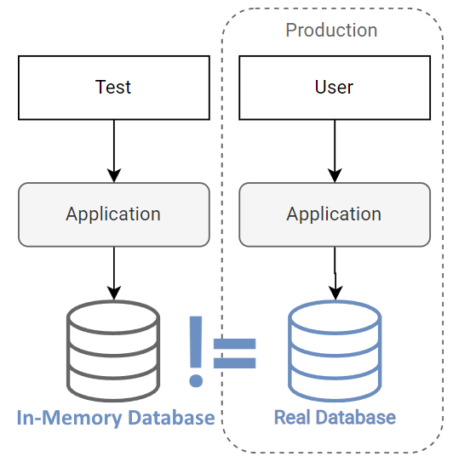
In-Memory Database
Data Storage in Memory

Slide 26
In-Memory Database
Services, accessing a Database, can (and should) also be tested
When testing such Services, you don't create a new Database
This would, otherwise, overload the Database Server
When testing such Service, you use In-Memory Database
Contains only synthetic data from the TestDb class
Test class
TestDb class
QA DB (in memory)
Test Case 1
Test Case 2
Test events
Test users
https://github.com/nakov/Eventures/blob/main/Eventures.Tests.Common/TestDb.cs
Created and dropped every time when tests are executed

Slide 27
EF Core In-Memory Database
EF Core provides an In-Memory Database
Included with the Microsoft.EntityFrameworkCore.InMemory package
Its general purpose is to be a testing database
public class CreditDecision
{
public int Id { get; set; }
public int Score { get; set; }
public string Decision { get; set; }
}
Create a db context as usual
public class AppDbContext : DbContext
{
public AppDbContext(DbContextOptions<AppDbContext> options)
: base(options) {}
public DbSet<CreditDecision> CreditDecisions { get; set; }
}

Slide 28
Testing a Service with In-memory Database (1)
public interface ICreditDecisionService
{
CreditDecision GetById(int id);
}
Inject the db context to the service
public class CreditDecisionService: ICreditDecisionService
{
private readonly AppDbContext data;
public CreditDecisionService(AppDbContext data)
=> this.data = data;
public CreditDecision GetById(int id)
=> this.data.CreditDecisions.Find(id);
}

Slide 29
Testing a Service with In-memory Database (2)
[TestFixture]
public class CreditDecisionDbTests
{
private IEnumerable<CreditDecision> decisions;
private AppDbContext dbContext;
[SetUp] // Method is executed before tests
public void TestInitialize()
{
this.decisions = new List<CreditDecision>() {
new CreditDecision(){ Id = 1, Score = 100, Decision = "Declined" },
new CreditDecision(){ Id = 2, Score = 600, Decision = "Maybe" },
new CreditDecision(){ Id = 3, Score = 800, Decision = "Absolutely" }};
var options = new DbContextOptionsBuilder<AppDbContext>()
.UseInMemoryDatabase(databaseName: "CreditsInMemoryDb") // Use an in-memory DB
.Options;
this.dbContext = new AppDbContext(options);
this.dbContext.AddRange(this.decisions); // Add data to the DB
this.dbContext.SaveChanges();
}
...
}
Create data for the in-memory db

Slide 30
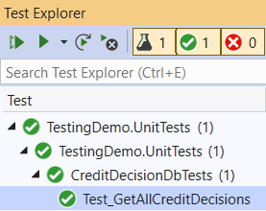
Testing a Service with In-memory Database (3)
[TestFixture]
public class CreditDecisionDbTests
{
...
[Test]
public void Test_GetAllCreditDescisions()
{
var decisionId = 1;
ICreditDecisionService service =
new CreditDecisionService(this.dbContext); // Pass the in-memory db to the service
var decision = service.GetById(decisionId); // Use service methods
var dbDecision = this.decisions
.ToList()
.Find(d => d.Id == decisionId);
// Compare and assert retuned CreditDecision from DB and from the service method
Assert.True(decision != null);
Assert.True(decision.Score == dbDecision.Score);
Assert.True(decision.Decision == dbDecision.Decision);
}
}

Slide 31

Integration Testing

Slide 32
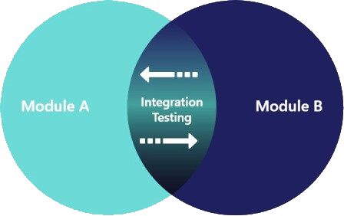


Integration Testing (1)
Integration testing tests several units (components) together
Aims to expose faults in the interaction between integrated units
Example: test user registration + data access services + database storage (if the new user is stored in the DB)
Unit testing vs. integration testing
Integration testing tests the interaction between several units
Unit testing tests a single unit (component)

Slide 33
Integration Testing (2)
ASP.NET Core supports Integration Testing using a Unit Test framework
The framework has an integrated web host and in-memory test server
Integration Tests follow a sequence of events
The app's web host must be configured
A test server client is created to submit requests to the app
[Arrange] The test app prepares a request
[Act] The client submits the request and receives a response
[Assert] The actual response is validated based on expected result
After all tests have run, the results are reported

Slide 34
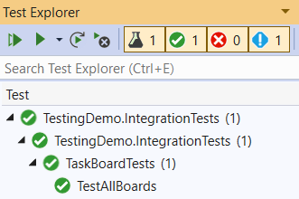
Integration Test for the TaskBoard App
[Test]
public async Task TestAllBoards()
{
// Arrange
var httpClient = new HttpClient();
// Act
var response = await httpClient
.GetAsync("https://taskboard.nakov.repl.co/boards");
// Assert
Assert.AreEqual(HttpStatusCode.OK, response.StatusCode);
}
Sends HTTP request and receives HTTP responses
Send a GET request
Make assertions

Slide 35
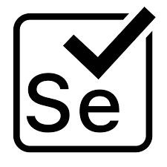
Selenium

Slide 36
Selenium
Selenium is a portable testing framework for web applications
Provides a playback tool for authoring tests (Selenium IDE)
Provides a test domain-specific language (Selenese)
Provides "browser driving" natively (Selenium WebDriver)
"Selenium automates browsers. That's it!" Selenium docs
Automates web applications for test purposes
Useful for integration testing SPA apps

Slide 37
Install and Set-up Selenium
Install latest stable Node.js: https://nodejs.org/en/
Install the npm package:
Install latest Java: https://www.java.com/en/download/
Download Selenium Standalone Server JAR
https://www.seleniumhq.org/download/
Download ChromeDriver (to match your Chrome version)
http://chromedriver.chromium.org/downloads
Extract the file in the same folder as Selenium Standalone Server
Start selenium server
npm install -g selenium-standalone
java -jar .\selenium-server-standalone-3.141.59.jar

Slide 38


Selenium and .NET
Let's get ready Selenium for ASP.NET Core App Testing
Install NuGet packages:
Selenium.Support
Selenium.WebDriver

Slide 39

MyTested.AspNetCore.Mvc

Slide 40
MyTested.AspNetCore.Mvc
MyTested.AspNetCore.Mvc is a powerful testing library
Automatic resolving of test dependencies
Fluent API with strongly-typed extensions
Unit tests, integration tests, route tests, everything covered
Built-in mocks for every ASP.NET Core scenario
Authentication, DbContext, HTTP, Session, Caching, and many more…
Examine at https://github.com/ivaylokenov/MyTested.AspNetCore.Mvc
Latest available version:
Install-Package MyTested.AspNetCore.Mvc.Universe -Version 3.1.2

Slide 41
MyTested.AspNetCore.Mvc (2)
// Instantiates controller with the registered global services,
// and mocks authenticated user,
// and tests for valid model state,
// and tests for added by the action view bag entry,
// and tests for view result and model with specific assertions
MyController<MyMvcController>
.Instance(instance => instance
.WithUser(user => user.WithUsername("MyUserName")))
.Calling(c => c.MyAction(myRequestModel))
.ShouldHave()
.ValidModelState()
.AndAlso().ShouldHave()
.ViewBag(viewBag => viewBag.ContainingEntry("MyViewBagProperty", "MyViewBagValue"))
.AndAlso().ShouldReturn()
.View(result => result
.WithModelOfType<MyResponseModel>()
.Passing(model =>
{
Assert.AreEqual(1, model.Id);
Assert.AreEqual("My property value", model.MyProperty);
}));

Slide 42
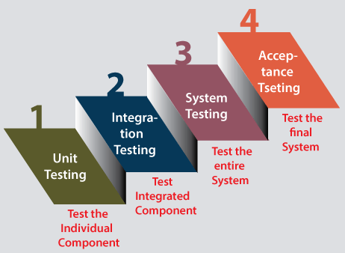
Summary
Testing
Unit Testing – testing a single unit
NUnit – a unit-testing framework
Mocking – simulating external dependencies
In-memory Database
Integration Testing – testing a combination of units
Selenium – automated tests in browser
MyTested.AspNetCore.Mvc
…
…
…

Slide 43
Questions?
Notes:
43

Slide 44










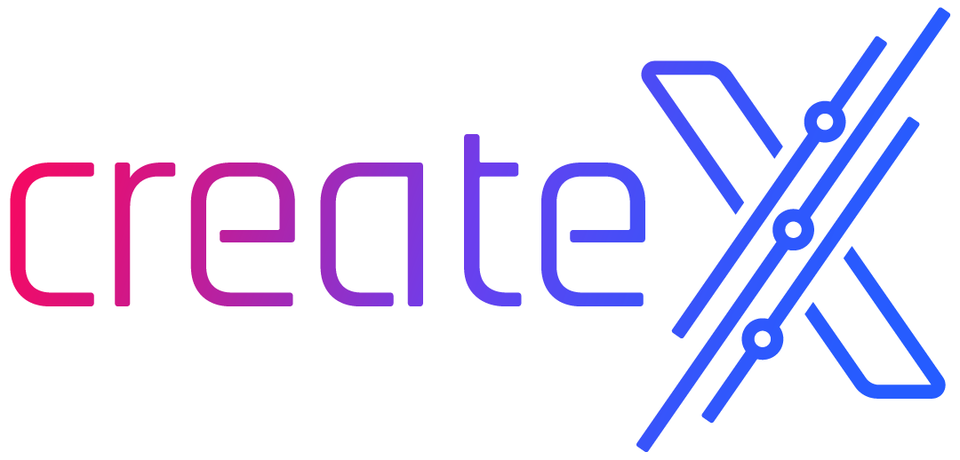


SoftUni Diamond Partners

Slide 45
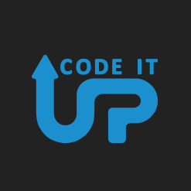
Educational Partners

Slide 46
Trainings @ Software University (SoftUni)
Software University – High-Quality Education, Profession and Job for Software Developers
softuni.bg, softuni.org
Software University Foundation
softuni.foundation
Software University @ Facebook
facebook.com/SoftwareUniversity
Software University Forums
forum.softuni.bg
Notes:
46

Slide 47

License
This course (slides, examples, demos, exercises, homework, documents, videos and other assets) is copyrighted content
Unauthorized copy, reproduction or use is illegal
© SoftUni – https://softuni.org
© Software University – https://softuni.bg
Notes:
47

